Slide 1
Agenda
Questions
Programming hardware lab overview
Solder paste application and part placement demo
Assembly group 1 assembles their chargers.

Slide 2
Programming The Hardware
Dr. Steven Swanson
CSE176e/276e
swanson@cs.ucsd.edu

Slide 3
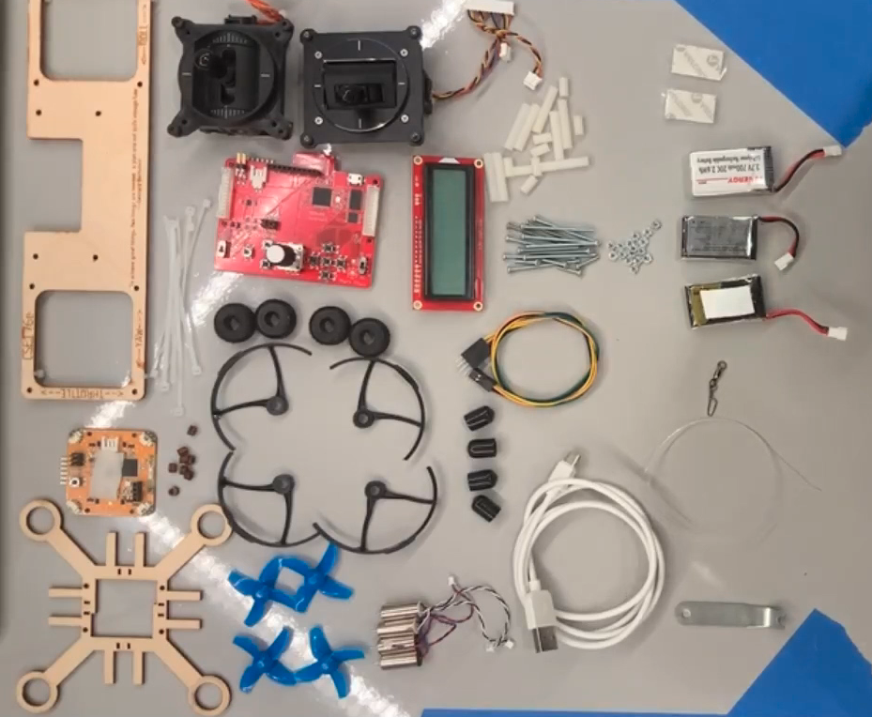
Assembling Everything
Detailed instructions in the lab
And a fancy video

Slide 4

Take Care of the Equipment
The remote and FCB are loaned to you.
Take care of them!!!
If you break them through neglect or abuse or loose them, you must pay for their replacement/repair.

Slide 5
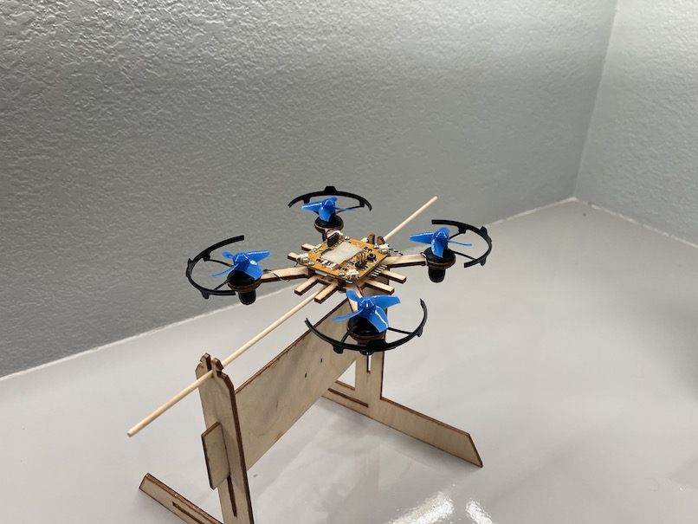
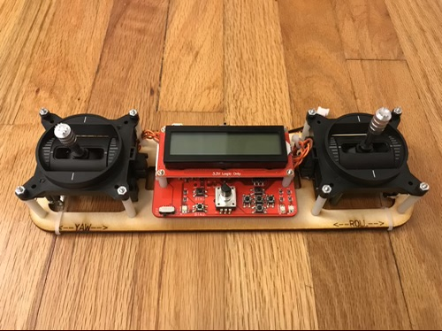
Software Plan
This Lab
Meet the hardware
Learn to use it
Sensing Lab – IMU Filtering
PID Lab – Implement control
Flight Lab – Flight!
Do everything on the Test Stand first, then move to your quadcopter

Slide 6
Quadcopter Firmware
Basic operation
Control motors
Read IMU
Sensing
Use the IMU to measure the orientation of the quadcopter
Filter IMU readings to eliminate noise
Control
Based on IMU measurements, maintain stability
Receive commands from remote
Implement them

Slide 7
Remote Firmware
Control
Measure gimbal position
Transmit readings to the quadcopter
Tuning
Your control algorithm will have many parameters
You’ll need to tune them in real time
Use the knob and buttons to make this easy
or don’t… and suffer the consequences (extreme tedium and slow progress on tuning)

Slide 8
This Lab
Use everything
Install IMU library. Read values from IMU.
Read the values from the gimbals.
Drive the motors.
Read values from the knob and buttons.
Build remote-controlled motors
FCB drives motors.
Remote control reads gimbals and transmits value to run motor at.
This is the basic framework for your quadcopter and remote firmware.

Slide 9
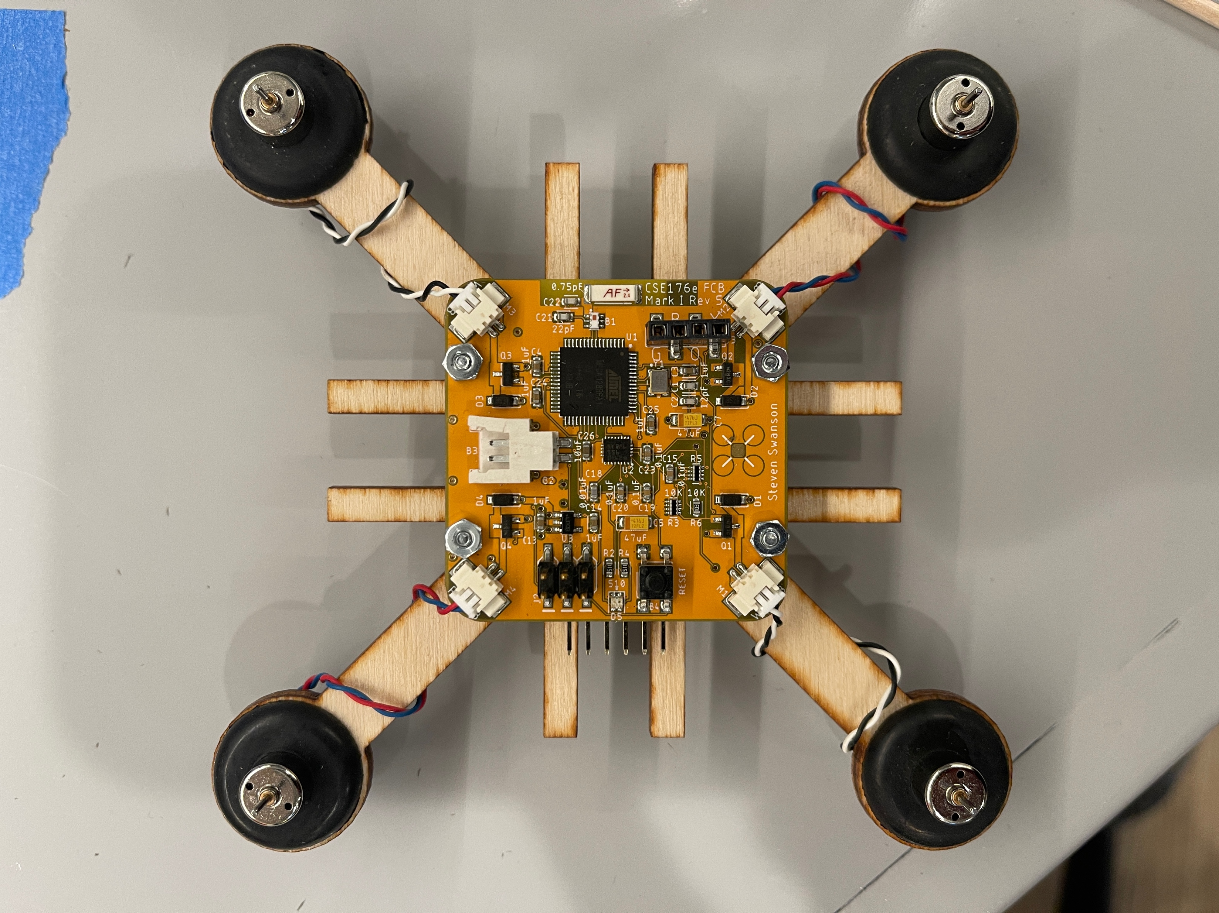
The Flight Control Board

Slide 10
The Hardware You Will Build

Slide 11
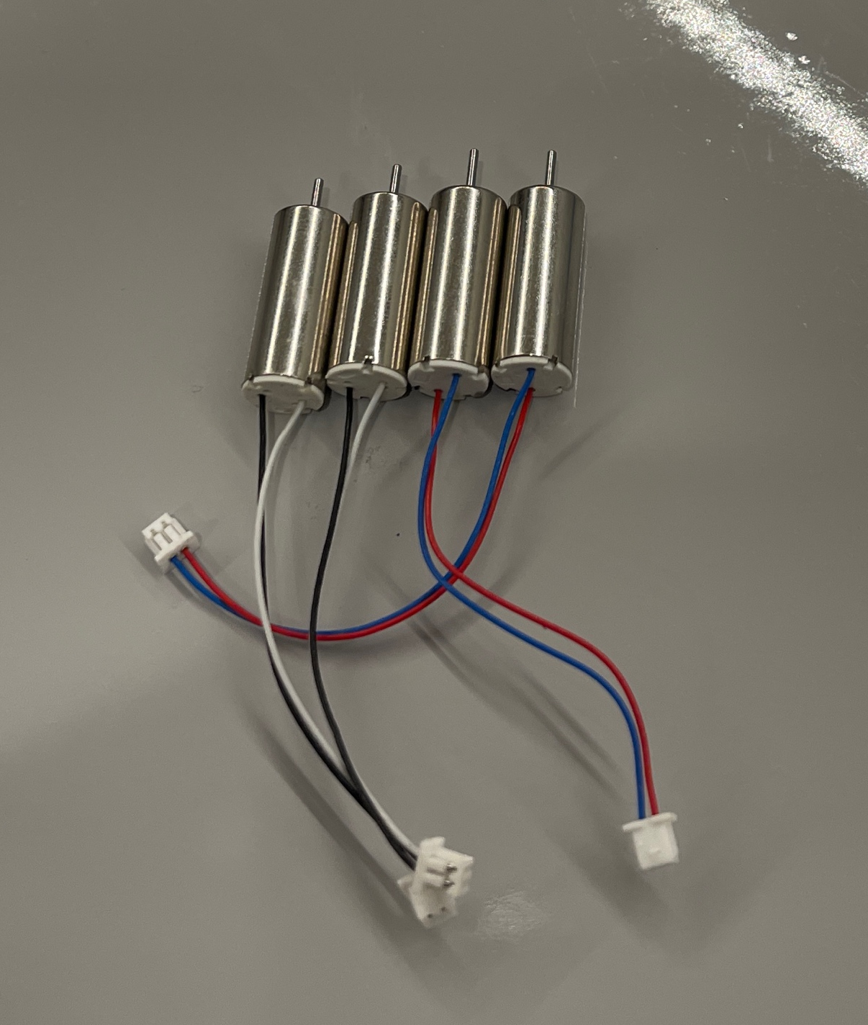
Brushed Motors
Speed ∝ Voltage ∝ Current
Vary the input voltage
Generating varying voltages is non-trivial.
You need a digital-to-analog converter
Really, we just need the average voltage to vary

Slide 12
Pulse Width Modulation
PWM varies the average voltage using a digital signal
Duty cycle: % of time signal is high
Cycle time: delay between rising edges (~2ms on our MCU – 490Hz)

Slide 13
PWM in Arduino
The motors are connected to the FCB via analog output (PWM) pins
analogWrite (int pin, int v)
‘v’ is the duty cycle (0…255)
‘pin’ is the the pin

Slide 14
The IMU

Slide 15
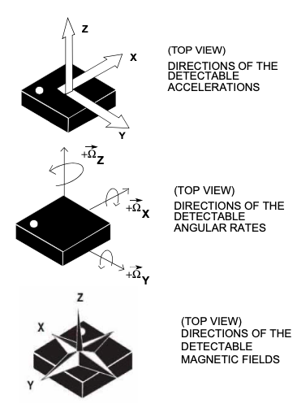
9-axis IMU
3-Axis accelerometer
Gravity + trigonometry = pitch and roll
3-Axis gyroscope
Directly measures rate of change for pitch, roll, and yaw
3-Axis magnetometer (compass)
Could measure yaw, in theory.
Calibration is hard, in practice.
We won’t use this.

Slide 16


IMU In Arduino
There’s a nice library for our IMU
It does the trigonometry for you
Provides convenient functions for reading all the values
Forked from Adafruit
Thanks, Limor Fried!
A lot more detail in the next lab

Slide 17
Powering the Quad
The FCB is powered by its battery.
It must be installed to program it.
There’s no power switch
Unplug the battery.
The FCB runs through batteries quickly
You can tell the battery is low when it starts resetting when you turn on the motors

Slide 18
The Remote

Slide 19
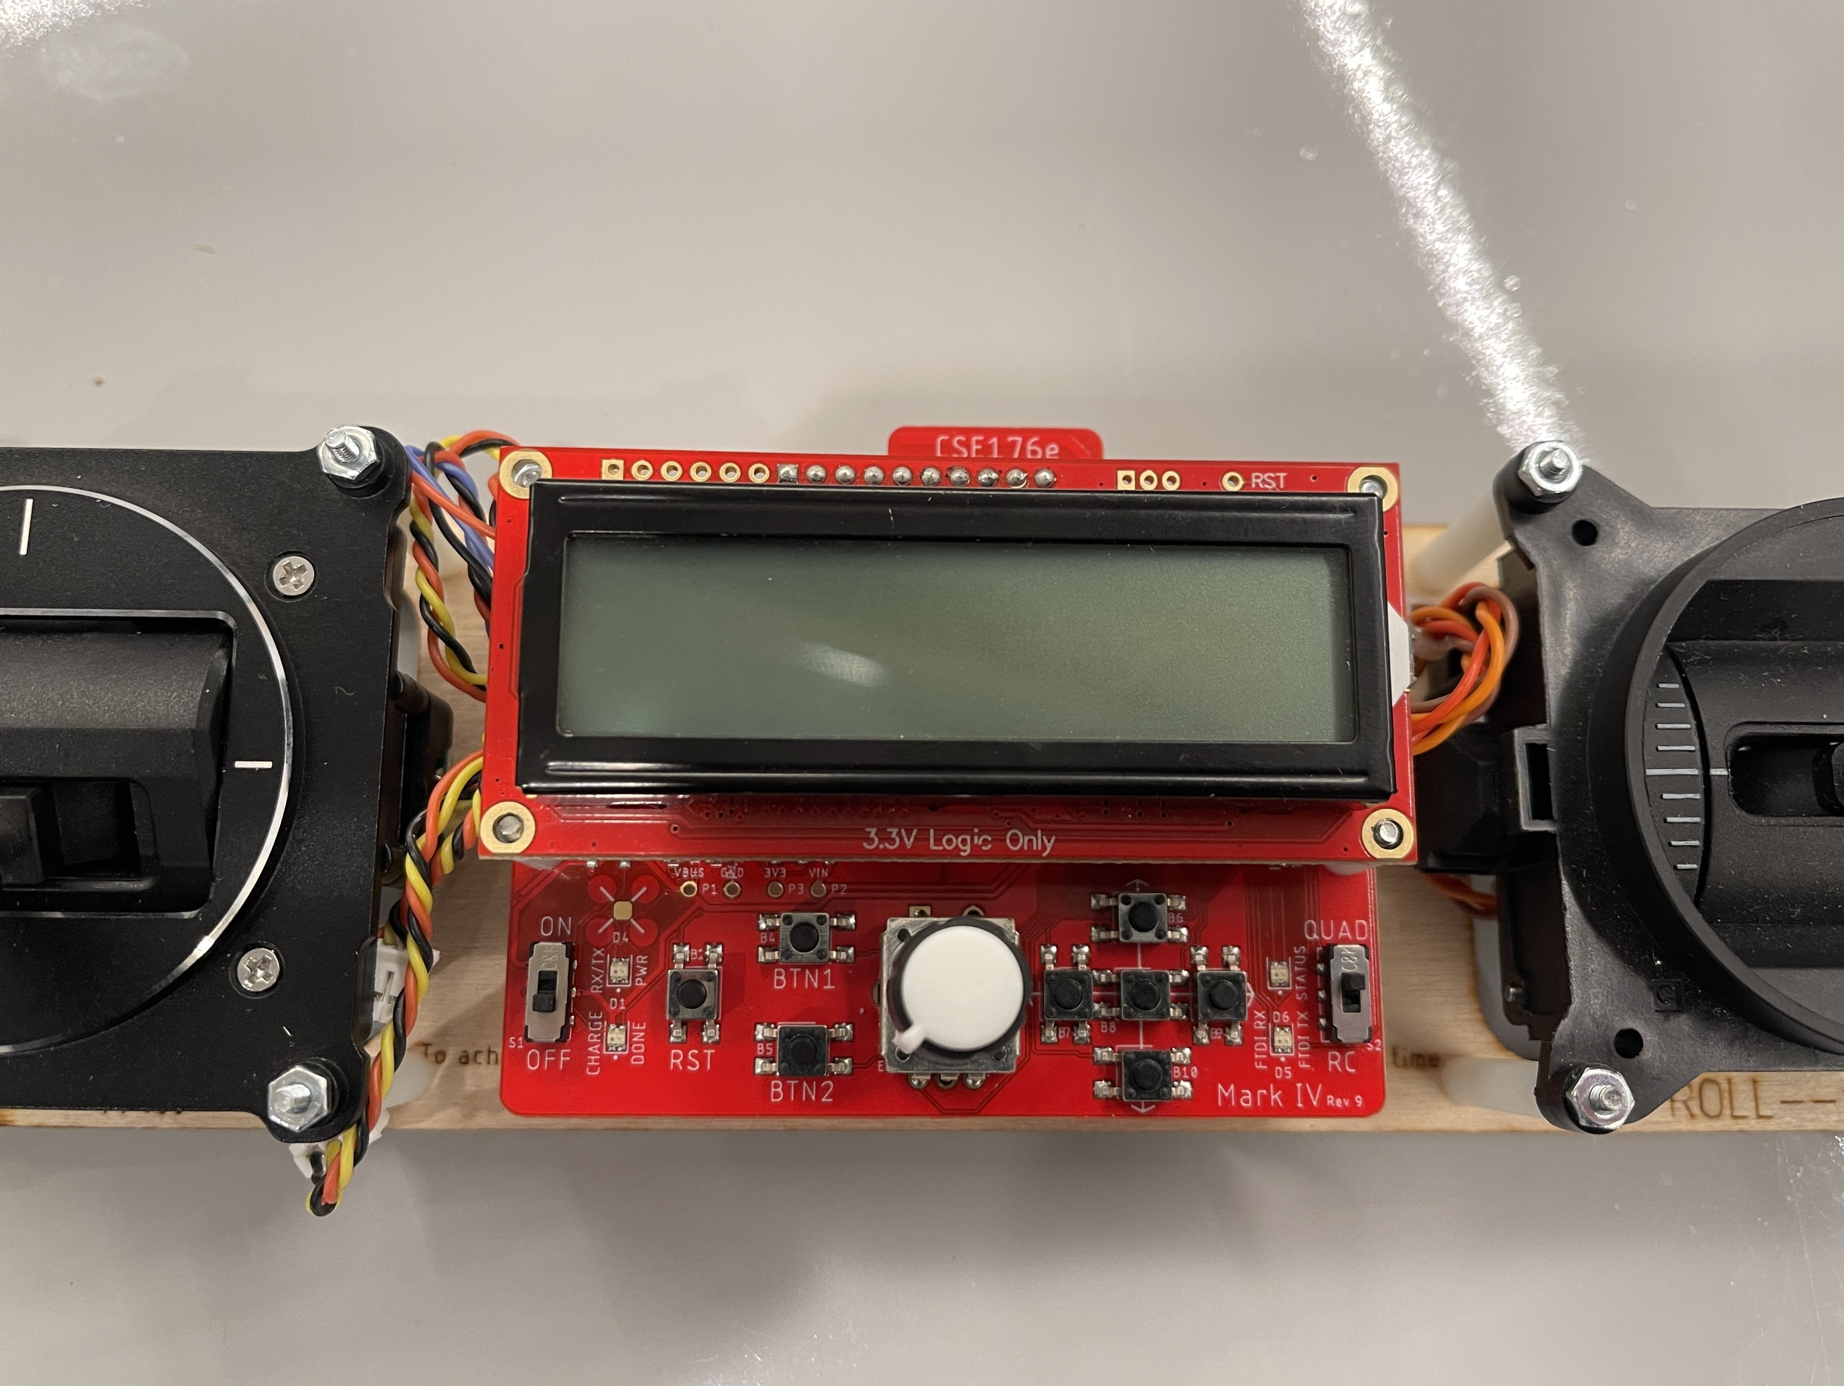
The Remote PCB
Microcontroller + radio
Identical to FCB
UI Controls
Mostly for tuning PID
Gimbal connectors
USB-Serial Arduino Programmer
For remote and FCB
Battery Charger
LCD

Slide 20
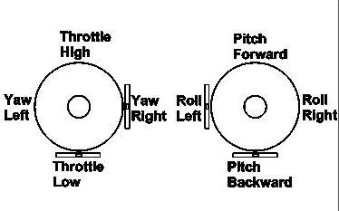
Gimbals
Gimbal: a mechanism, typically consisting of rings pivoted at right angles
Standard aircraft controls
Left: throttle and yaw
Right: pitch and roll
Yaw, pitch, and roll are spring-loaded to return to neutral
Throttle stays where you put it.

Slide 21
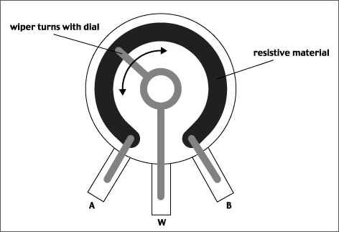
Anatomy of a Gimbal
Two potentiometers measure X and Y movement of the stick.
Potentiometer – A variable voltage divider
As the slider’s movement changes the resistance from A and W and W and B.
The voltage at W is proportional to the position of the gimbal.
The resistances are always > 0, so V_{W} never reaches V_{A} or V_{B}.
Our gimbal
Frsky PR10 – common in quad remotes
Total resistance: 2.4KOhms
Rated voltage: 5V
V_{A} = 0
V_{B} = 3.3V
V_{A-W} + V_{W-B} = V_{B}-V_{A}
AnalogRead() = V_{W}/V_{B} * 1024

Slide 22
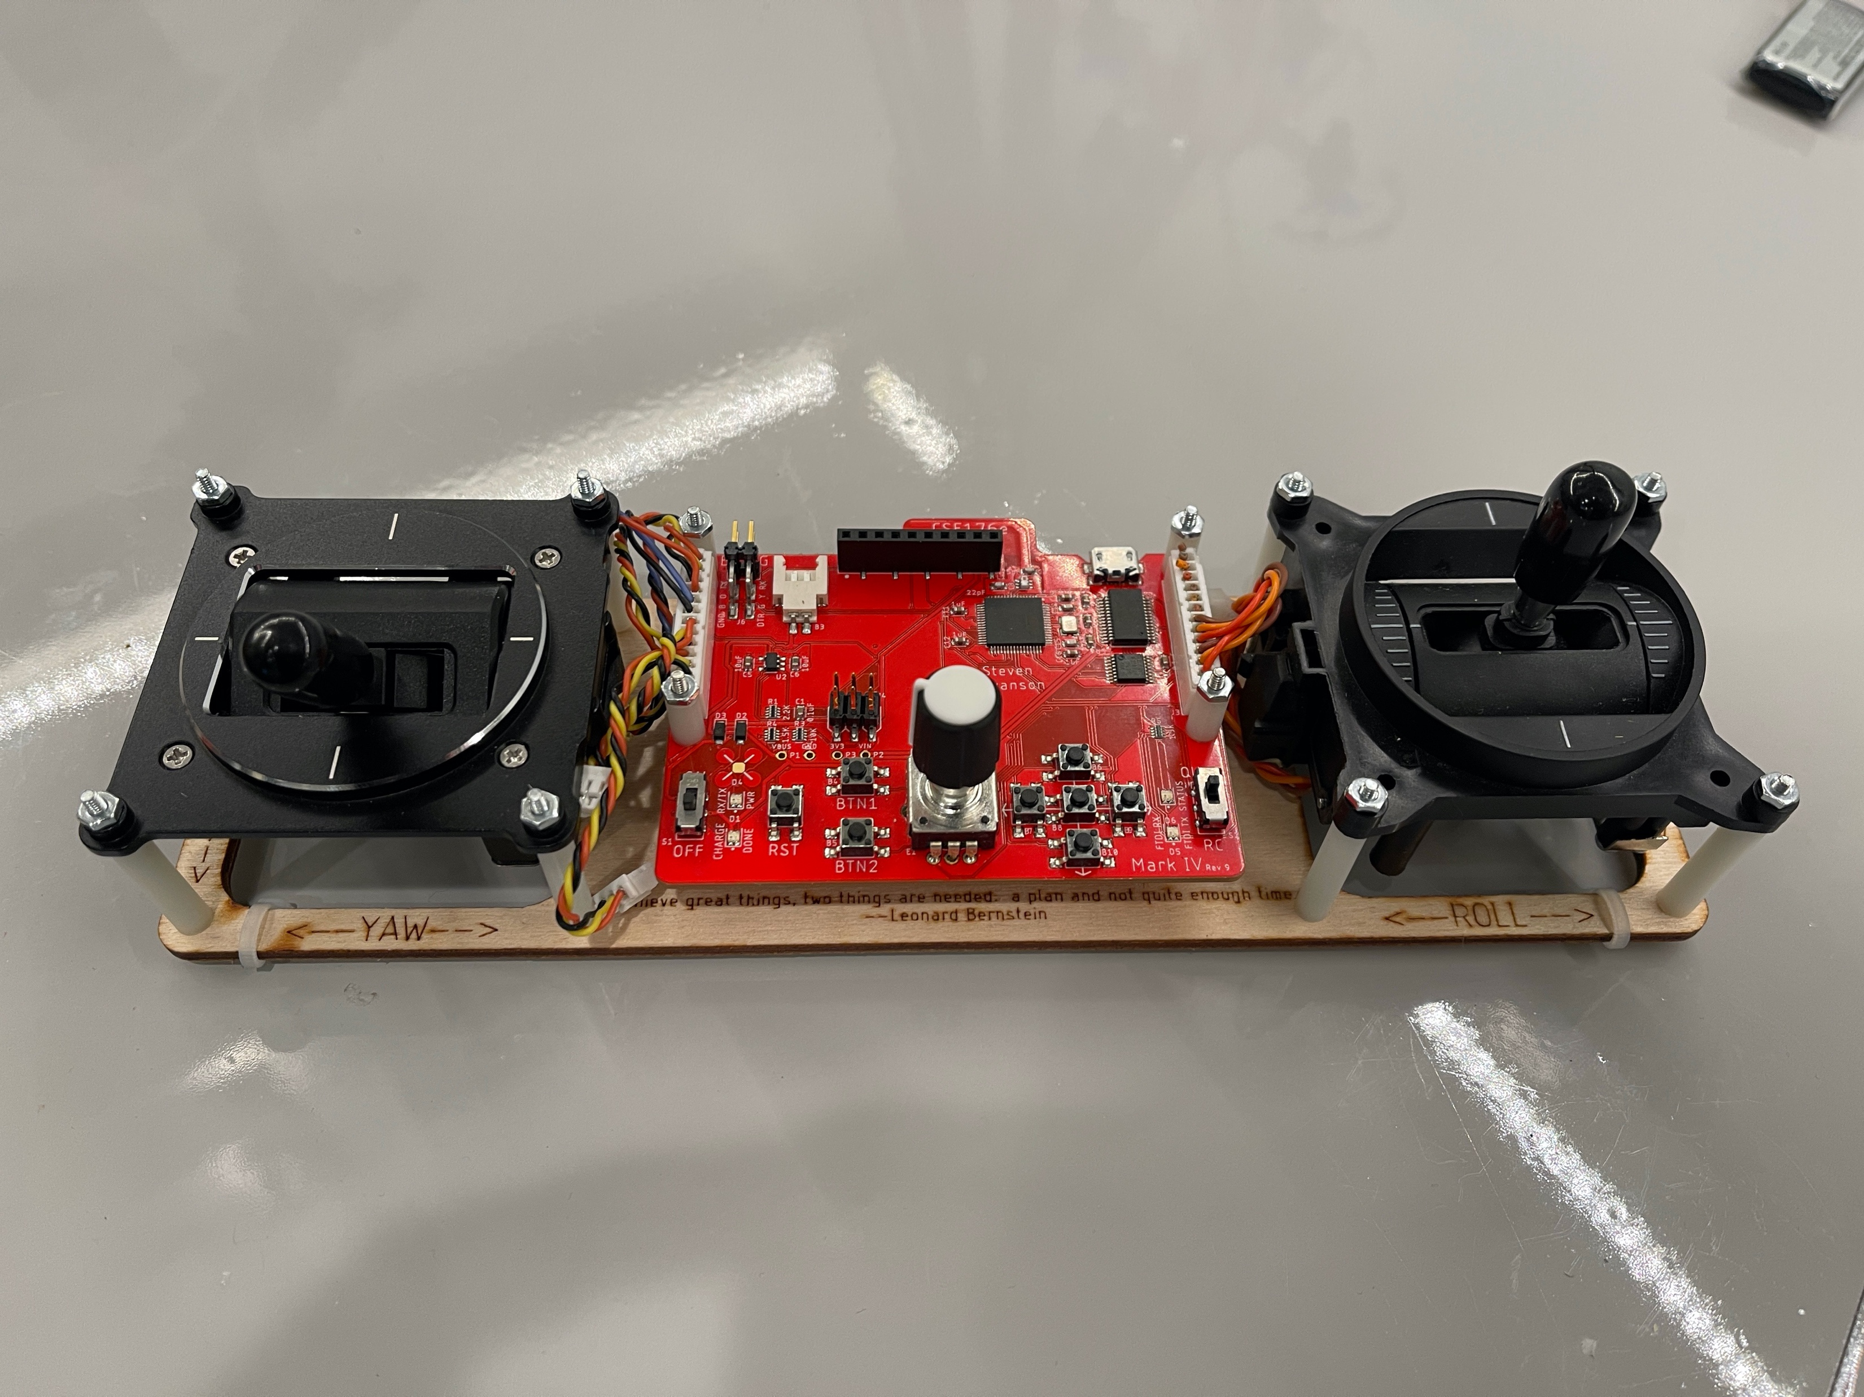
Reading the Gimbals
The gimbals are connected to analog input pins on the MCU
analogRead(int pin)
Takes a voltage between GND and Vcc and maps it to 0—1024
The Remote library defines constants for which pins to read.
firmware/libraries/Remote/quad_remote.h

Slide 23
Status LEDs
The remote has 2 status LEDs
They are useful for letting you know when the quad is armed, etc.
Use digital_write() to control them.
See quad_remote.h for pins

Slide 24
Buttons
The remote has 7 buttons.
1 ”D-pad” – up, down, left, right, center
2 others (btn1, btn2)
The Remote library has two interfaces
Call-backs: A function that is called when a button is pressed.
is_pressed(): Check if a button is currently pressed.
Potential problems
Sometimes one press appears as several due to “bouncing”

Slide 25
Rotary Encoder
The knob is ‘rotary encoder’
It can turn indefinitely in either direction.
The Remote library tracks its movement
Query current value with: knob1.getCurrentPos ()
Set current value with: knob1.setCurrentPos()
The knob also has a built-in button. It works just like the others.

Slide 26
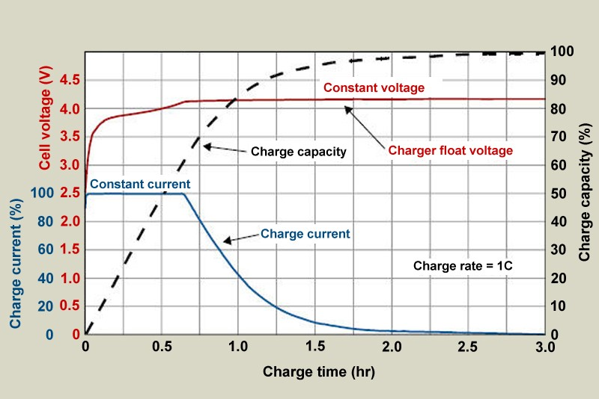
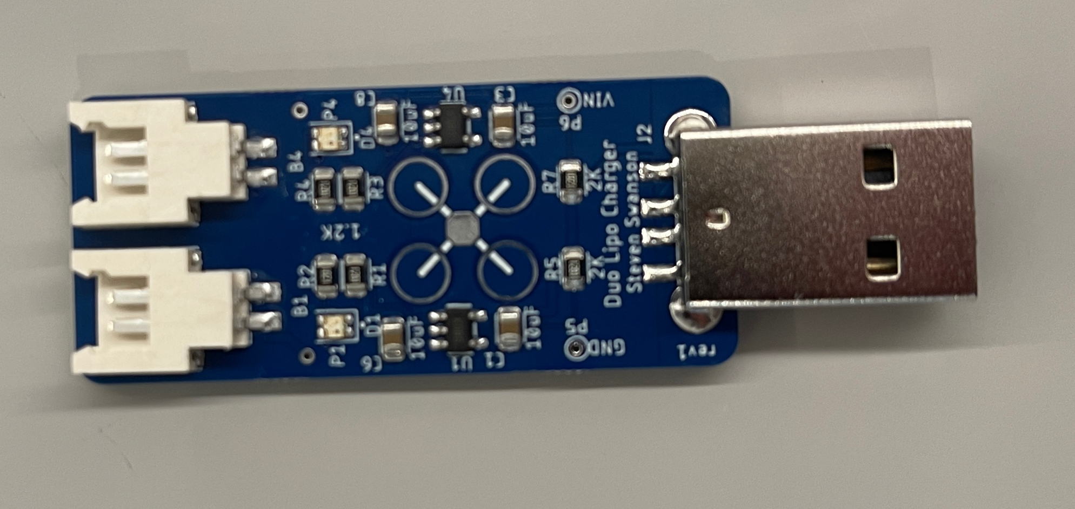
Battery Chargers
Remote’s integrated battery charger
Powered via USB
It draws less than 500mA, which is the USB standard
Duo LiPo charger
Usually, we assemble this in class
Needs a higher-powered USB port (like a tablet charger)
~1A max (with two batteries constant-current charging)
It gets a little hot
Status lights
Green means charged
Red means charging
Both mean no battery
The FCB/Quad runs through batteries fast
Keep chargers occupied

Slide 27
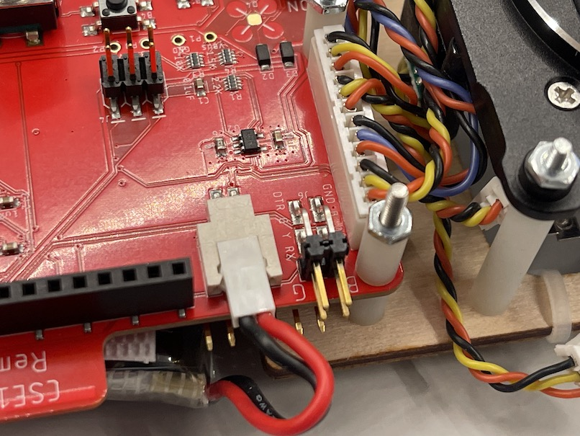
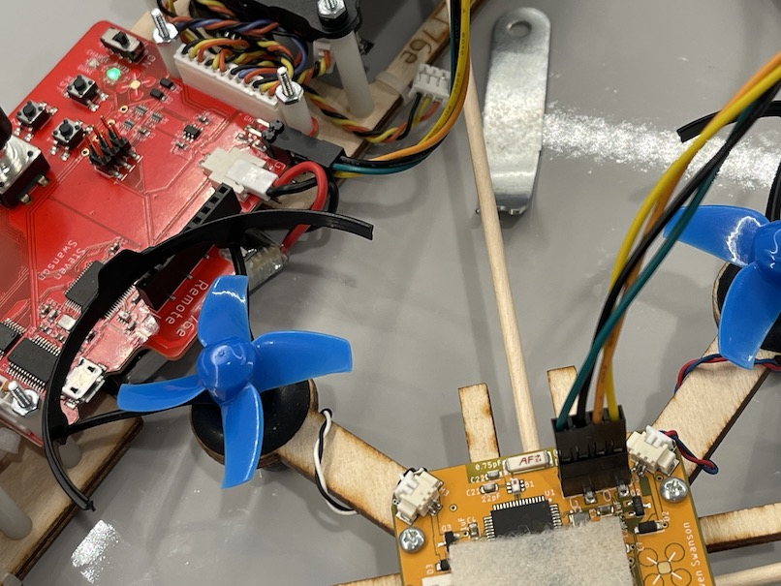
Arduino Programmer
A USB-serial converter connects to your laptop
The switch at lower-right routes the serial line
Remote control MCU (“RC”)
4-pin programming port (“QUAD”)
Match ‘B’ to black wire and ‘G’ to green wire.
The remote programs itself and the quadcopter via USB
Serial debugging with Arduino

Slide 28
LCD
The LCD can provide feedback to the pilot.
UI for calibration and tuning
The Remote library defines an object called `lcd`
You write to it just like a serial port.
Some other operations too.
See lab and examples.
It has a RGB backlight ☺

Slide 29
The Radio

Slide 30
Standard and Software Interface
The remote, FCB, and your quadcopter use the same radio.
2.4GHz IEEE 802.15.4
Physical and media access control (MAC) layers
Common basis for embedded wireless standard (e.g., Zigbee, 6LoWPAN)
The ‘Radio.h’ library provides access.
There are 11 channels
Eaglint will allocate your team a channel when you create your group.
Since you are at home, the channel doesn’t matter that much. You can use whatever you like. Some will be noisier around your house than others.
It’s not private, so you must share nicely – don’t transmit constantly
Set your channel with: rfBegin(WIRELESS_CHANNEL);
Send data with: rfWrite(<data>)
Receive data (if available) with : rfRead(<data>)

Slide 31
Radio: What To Send
You must define the packet format for your remote/quad.
The easiest thing to do is define a struct that has everything you need.
It can be up to 128 bytes
You must reject packets from other sources (noise and other teams)
Include a ‘magic number’, unique to your team
Include a checksum (highly recommended)
Always check the length of the data you read (it should match the size of your struct)
You will need to send telemetry from the quad too
At least to managing arming properly.
And whatever else you want.
You can (and probably should) use a different packet format.

Slide 32
For Next time:
Add a slide about sparsing the stream of bytes and how to get re-aligned if you miss something.

Slide 33
Remote Controlled Motors

Slide 34
The Basics for Your Remote and Quad Firmware
Remote
Read user input
Build a simple user interface
Transmit commands to the quadcopter
Calibration
Arming (for safety)
Quadcopter
Receive commands
Control the motors
Arming (for safety)

Slide 35
Remote Software Path
Scale and bound gimbal readings
P, Y, R: -128 to 127
T: 0 to 255
Tuning parameters
Set tuning parameters with the UI
Send them to the quadcopter
Transmit updates at 10-20Hz.
No faster – share the spectrum!

Slide 36
Quadcopter Datapath for This Lab
Read the throttle
Control the motors
Separately: Verify you can read the IMU

Slide 37
Arming the Quad
Your motors should not turn on accidently (e.g., by default, if the throttle happens to be on, if you bump the throttle) – it’s dangerous
Your firmware must properly ”arm” the quadcopter
Push the gimbals out and down (left to lower left, right to lower right)
Forces throttle to zero.
Unlikely to happen by accident.
Turn on an LED on the FCB when it is armed.
Turn off the LED when it’s disarmed.
Resetting the remote or the FCB should disarm both.

Slide 38
Calibration
The actual range of values from your gimbals will vary.
You need a consistent range to control your quad.
Your remote needs a calibration mode where it learns the actual range
You should map the actual range to (0-255) for throttle, and (-128 to 127) for everything else
Requirements
Calibration mode should only be available when the FCB is disarmed
You must save the calibration measurements in the MCU’s EEPROM (see lab for details)
You must provide some feed back via the LCD so the user knows what’s going on.

Slide 39
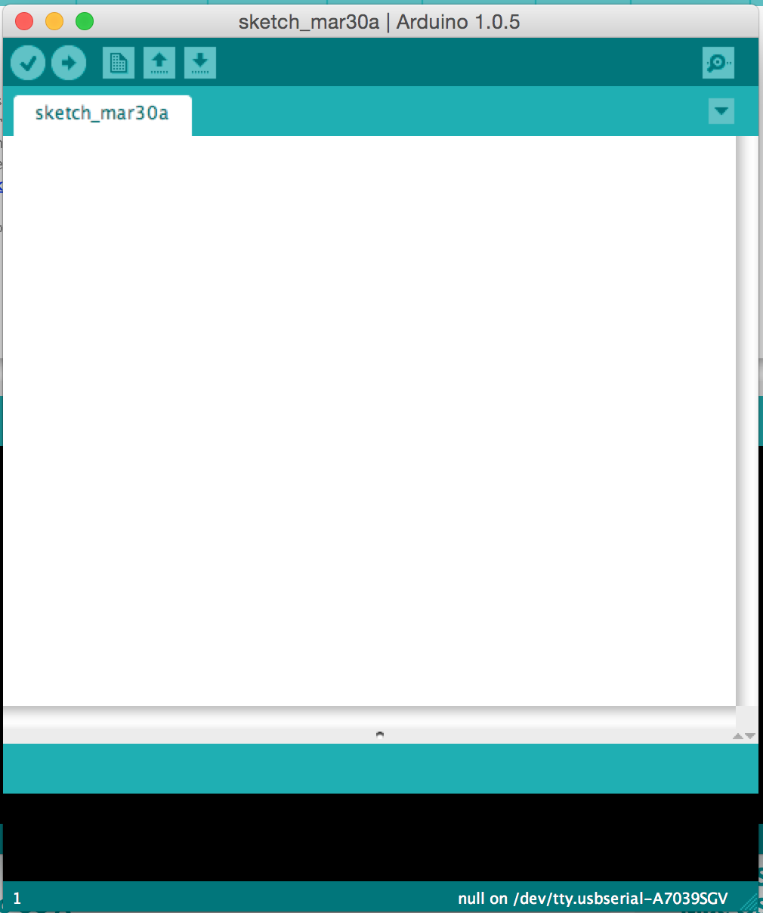
Programming the FCB and the Remote with the Arduino IDE
User-friendly IDE for Arduino programming
Programming the microcontroller is easy
Installation is easy
Use version >= 1.8.12
Settings
Tools->Board->Quad Class Atmega…
Tools->programmer->USBTinyISP
Tools->Port->Com n (windows, choose largest n available)
Tools->Port->cu… (pick the one that appeared when you plugged in the remote)

Slide 40
Demo
Walk through knobs_and_buttons.ino
Demo solution

Slide 41
Form groups
This lab (and all future) are in (the same) groups of two.
Create group on eaglint
Create group assignment on github classroom
Use exactly the same name!

Slide 42
Assemble the Remote and Test Stand
Come up and get a kit.
Get started.
Instructions are and photos are in the lab.
There’s a video online.

Slide 43
The End

Slide 44
Assembling the Quadcopter and Remote
Dr. Steven Swanson
CSE176e/276e
swanson@cs.ucsd.edu

Slide 45
Programming The Hardware Lab Checklist Demo
Dr. Steven Swanson
CSE176e/276e
swanson@cs.ucsd.edu

Slide 46
Changing the Polarity of Your Motors
Dr. Steven Swanson
CSE176e/276e
swanson@cs.ucsd.edu

Slide 47
Next Time
30 minutes of questions
70 minutes of lecture
They completed assembly of the remotes and test stands in 1-2 hours.

Slide 48
Maintaining Stability
Multi-rotor aircraft are inherently unstable
Mismatched motor power (voltage variation, manufacturing variation in motors or props)
Variation in air currents and density.
Once perturbed, there’s no force acting on the aircraft to return it to equilibrium.

Slide 49
Maintaining Stability
Multi-rotor aircraft require a closed loop controller
Sensors detect aircraft movement and orientation
Controller adjusts the power to motors to maintain desired location and orientation
Multi-rotor aircraft use a few sensors to maintain stability
Accelerometers (absolute pitch and roll)
Gyroscopes (changes in pitch, roll, and yaw)
The flight computer implements the control algorithm
Usually a proportional, integral, derivative (PID) controller implemented in software.
We will talk more about this later.
With PID controllers for pitch, yaw, and roll multirotor aircraft can achieve stable flight.

Slide 50
Higher-order Navigation
Large multi-rotor aircraft can do more
Maintain geographic position
Maintain altitude
Follow an prescribed/pre-programmed path
More sensors required
Magnetometers (absolute yaw or heading)
GPS (absolute location and altitude)
Barometers (altitude)

Slide 51
Demos
Show PWM signal changing duty cycle
Show flyback
Effect of diode
Show effect on power supply noise
Show filter on pwm line
Effect of resistor and capacitor on PWM
Show output of FET
Show affect of filter on power supply noise

Slide 52
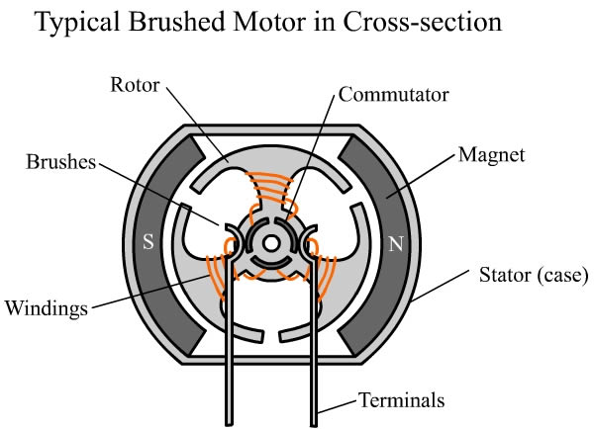
Construction

Slide 53
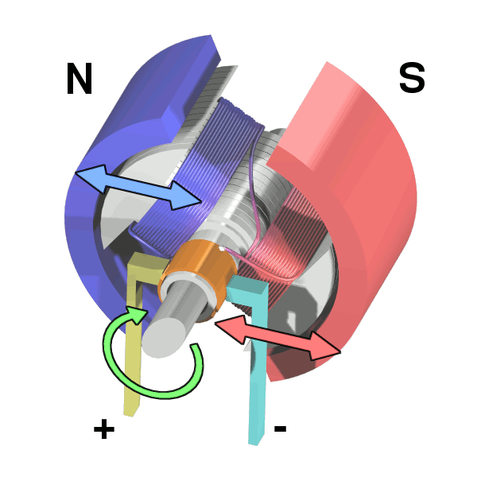
Operation

Slide 54
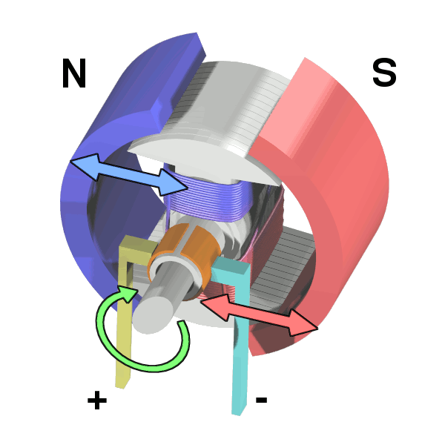
Operation

Slide 55
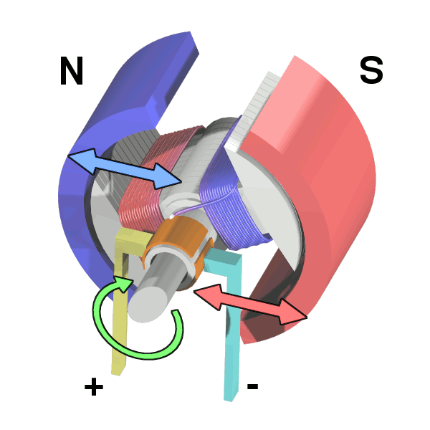
Operation

Slide 56
Operation

Slide 57
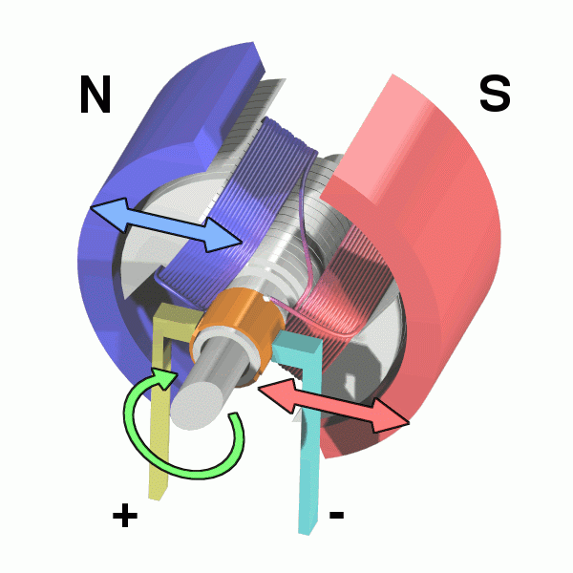
Operation

